Slide 1
Prineville LIT: Conservation Actions
Information available from the
Conservation Efforts Database (CED)
https://conservationefforts.org/

Slide 2
Purpose of CED Data
Purpose: Collect information on conservation actions across large, multi-jurisdictional landscapes. Used in the USFWS 2015 sage-grouse listing decision and WAFWA 2020 sage-grouse assessment, and will be used for Oregon Action Plan reporting, LITs, etc
What it collects: Spatial, semi-spatial and non-spatial information about conservation actions on public and private lands
What it does not collect: Funding allocations or $ spent, spatial data on private lands, information on habitat, development projects, etc
Time frame of data
  2015-2018 – high quality data
  2010-2014 – variable completeness and quality
Final data delivered to Oregon later this month

Slide 3
Actions Entered in the CED: 4 Major Categories
ACTIVITIES ON PUBLIC LANDS
ACTIVITIES ON PRIVATE LANDS
Public Lands: Actions Addressing Major Threats Driving Habitat Loss
SPATIAL: treatment footprint required
1
3
Private Lands: All Actions
Reported by Sagebrush Reporting Unit
(unless landowner permission to share spatial information)
Conservation easement
Land acquisition
Fuel break
Conifer removal
Fuels management
Area closure
Veg mgmt/enhancement
Annual grass treatment
Weed treatment
Riparian
Reclamation
Sagebrush protection
Conifer removal
Habitat enhancement
Sagebrush protection
Conifer removal
Habitat enhancement
Infrastructure modification
Livestock management
Travel management
Species management
Feral equids
(see subactivity list under Public Lands)
2
Public Lands: Addressing Other Threats
NON-SPATIAL: reported by County
PLANS
(no spatial information required)
Infrastructure modification
Livestock mgmt
Travel mgmt
Species mgmt
Feral equids
Structure removal
Powerline burial or retrofitting
Fence modification, marking, removal
Improved grazing
Road or trail closure
Rerouted roads or trails
Translocation
Feral equid population control
Feral equid gather
4
Regulatory mechanisms (plans, policies, agreements, etc)
Non-regulatory mechanisms (plans, strategies, etc)

Slide 4
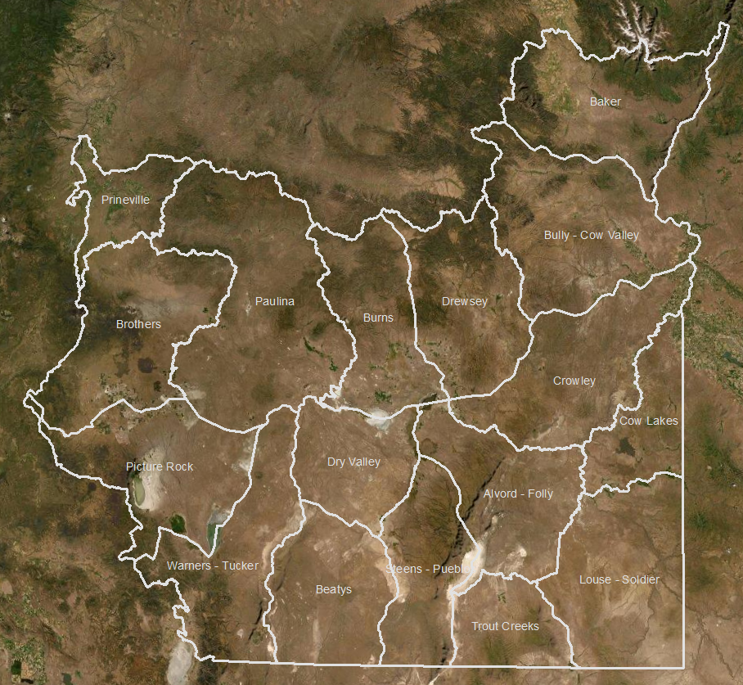
Sagebrush Reporting Units (SRUs)
Semi-spatial unit for reporting private land actions
Protect privacy of landowners
Unit for summarizing all data across Oregon
Based on BLM HAF polygons, modified to combine some adjacent polygons
Centered around PACs, cover all lands

Slide 5
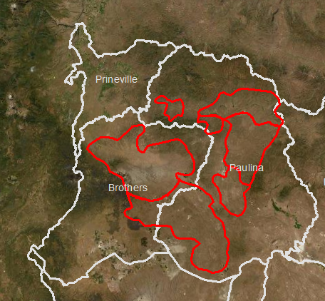
Sagebrush Reporting Units (SRUs) – Prineville Area
SRUs in light gray
Prineville action areas in red

Slide 6
Primary Actions in Oregon
ACTIVITIES ON PUBLIC LANDS
ACTIVITIES ON PRIVATE LANDS
Public Lands: Actions Addressing Major Threats Driving Habitat Loss
SPATIAL: treatment footprint required
1
3
Private Lands: All Actions
Reported by Sagebrush Reporting Unit
(unless landowner permission to share spatial information)
Conservation easement
Land acquisition
Fuel break
Conifer removal
Fuels management
Area closure
Veg mgmt/enhancement
Annual grass treatment
Weed treatment
Riparian
Reclamation
Sagebrush protection
Conifer removal
Habitat enhancement
Sagebrush protection
Conifer removal
Habitat enhancement
Infrastructure modification
Livestock management
Travel management
Species management
Feral equids
(see subactivity list under Public Lands)
2
Public Lands: Addressing Other Threats
NON-SPATIAL: reported by County
PLANS
(no spatial information required)
Infrastructure modification
Livestock mgmt
Travel mgmt
Species mgmt
Feral equids
Structure removal
Powerline burial or retrofitting
Fence modification, marking, removal
Improved grazing
Road or trail closure
Rerouted roads or trails
Translocation
Feral equid population control
Feral equid gather
4
Regulatory mechanisms (plans, policies, agreements, etc)
Non-regulatory mechanisms (plans, strategies, etc)

Slide 7
Information Entered in the CED
Basic information
  Project name
  Status – in progress or completed
  Implementing party
  Collaborators
  Land ownership
  Start and end dates
Location information
  Public spatial – Project footprint (polygon of treated area)
  Public non-spatial – County
  Private – Sagebrush reporting unit
Activity information
  Activity and subactivity type (action type)
  Quantity (acres or miles)
  Threats addressed
Objectives, methods and effectiveness information
  Choose from pre-defined categories
Note: some subactivities require additional information
  Post-fire check box
  Mitigation check box
1
2
3

Slide 8
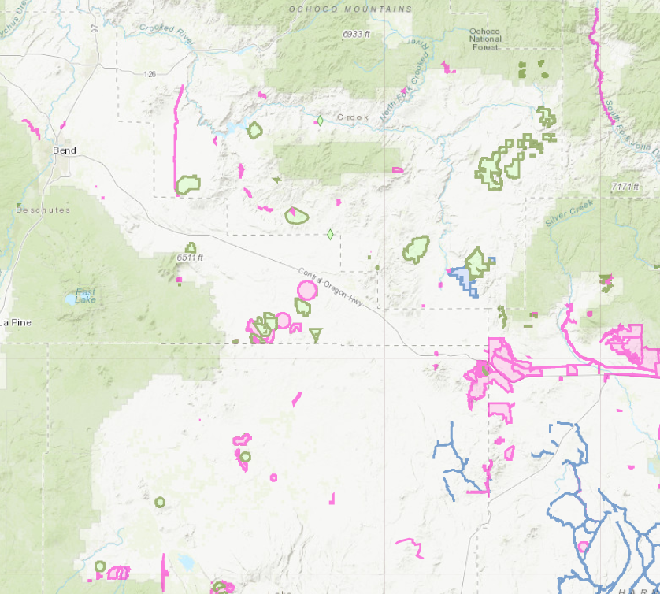
Prineville Projects – Public lands
ACTIVITIES ON PUBLIC LANDS
Public Lands: Actions Addressing Major Threats Driving Habitat Loss
SPATIAL: treatment footprint required
1
Conservation easement
Land acquisition
Fuel break
Conifer removal
Fuels management
Area closure
Veg mgmt/enhancement
Annual grass treatment
Weed treatment
Riparian
Reclamation
Sagebrush protection
Conifer removal
Habitat enhancement

Slide 9
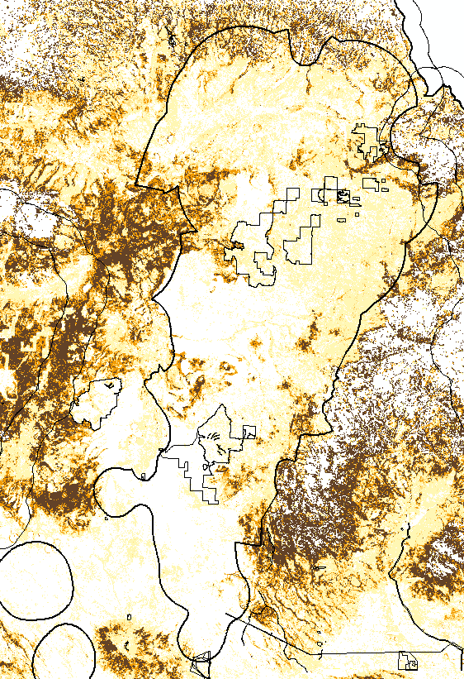

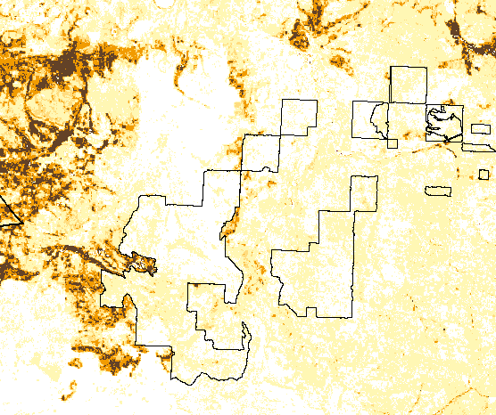
Prineville Projects – Public lands
Juniper removal treatments
in Paulina PAC
Conifer cover map (RAP v2)
0%
1-5%
6-10%
11-20%
>20%
Inset of juniper removal

Slide 10
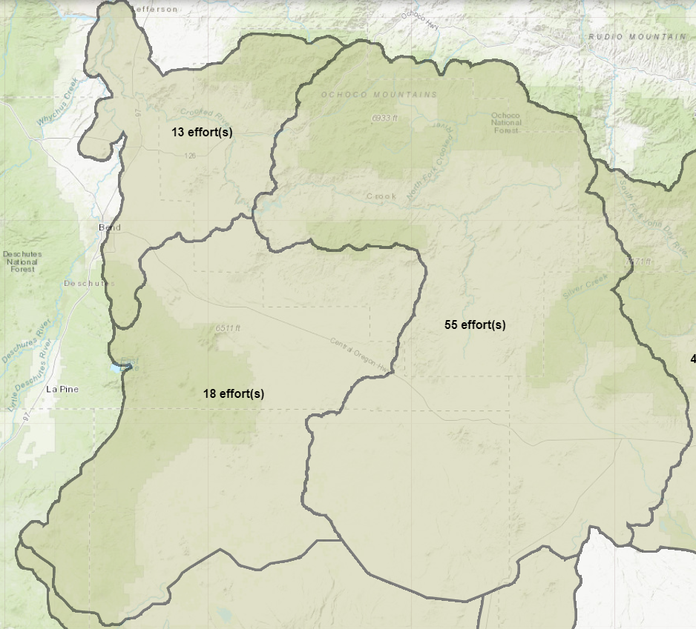
Prineville Projects – Private lands
Example:
Project Name: WLFWconifer216
SRU: Paulina
Implementing party: NRCS
Type: Conifer removal
Year: 2016
Acres: 9,511
(this entry includes all conifer removals done by NRCS within the year 2016 and the Paulina SRU)
Prineville SRU
ACTIVITIES ON PRIVATE LANDS
3
Private Lands: All Actions
Reported by Sagebrush Reporting Unit
(unless landowner permission to share spatial information)
Sagebrush protection
Conifer removal
Habitat enhancement
Infrastructure modification
Livestock management
Travel management
Species management
Feral equids
Paulina SRU
(see subactivity list under Public Lands)
Brothers SRU

Slide 11
Guidelines on using the CED
Actions are summarized by threat, and summing actions across all categories can result in an inaccurate total. For instance, a project may include conifer removal, removal of slash (fuels management), herbicide application (annual grass treatment) and seeding (vegetation management). These actions are each reported separately because they address different threats.
The CED records actions implemented, which does not necessarily reflect habitat restored. Habitat value cannot be measured based on implemented actions alone.
The CED data does not necessarily reflect the official data of each agency and contains both known and unknown errors and omissions.

Slide 12
Key questions for the LIT
How will this information be used by the LIT?
  Strategic action plan
  Future project planning
  Facilitating discussions
  Reporting accomplishments
  Effectiveness monitoring?? (using maps)
What are the gaps – pieces of information needed that we do not have?
Is additional information on private lands needed? What is feasible to acquire? At what scale?
Is there a need for QA/QC of data locally?

Slide 13
Examples of Common Activities Entered in the CED
Threat Addressed | Example Treatment | CED Activity | CED Subactivity
Conifer encroachment and/or Fire | Cutting or burning of conifer trees (does NOT include slash removal) | Restoration: Conifer removal | Conifer removal
Invasives | Application of herbicide to reduce annual grass (does NOT include post-herbicide seeding) | Restoration: post-disturb/habitat enhance | Annual grass treatment
Invasives / Habitat degradation | Seeding following another treatment (herbicide, conifer removal) | Restoration: post-disturb/habitat enhance | Vegetation management / habitat enhancement
Invasives | Targeted grazing to reduce annual grass | Restoration: post-disturb/habitat enhance | Annual grass treatment
Fire | Green or brown strip | Sagebrush protection | Fuel breaks
Fire | Thinning or other fuels treatment (does NOT include conifer removal) | Restoration: post-disturb/habitat enhance | Fuels management
Fire | Removal of slash following conifer removal (does NOT include original conifer removal) | Restoration: post-disturb/habitat enhance | Fuels management
Invasives | Herbicide application to noxious weeds (does NOT include post-herbicide seeding) | Restoration: post-disturb/habitat enhance | Annual forb or noxious weed
Habitat degradation | Seeding of desirable species to improve vegetation condition | Restoration: post-disturb/habitat enhance | Vegetation management / habitat enhancement
Improper grazing | Rest rotation or other grazing practices (does NOT include targeted grazing for annual grass) | Restoration: livestock management | Improved grazing practices
Habitat loss or degradation | Installation of Zeedyk structures or other practices to retain moisture in riparian areas | Restoration: post-disturb/habitat enhance | Riparian restoration
Agriculture / Development | Acres enrolled in a Programmatic CCA (individual treatments entered separately) | Regulatory Mechanisms | Programmatic Candidate Conservation Agreement
Habitat loss or degradation | Other treatments (augmenting canopy coverage, understory species diversity, managing shrubs) | Restoration: post-disturb/habitat enhance | Vegetation management / habitat enhancement

Slide 14
Examples of Common Activities Entered in the CED
The CED organizes actions based on the threats addressed. Therefore, some treatments that are part of a single project or property will be categorized under multiple activities. This allows the CED to summarize the efforts aimed at reducing or removing impacts associated with a particular threat.
Example: Potential treatments associated with juniper removal
Cutting or burning trees – Conifer removal
Piling and/or removing slash – Fuels management
Herbicide treatment – Annual grass treatment OR Noxious weed treatment
Seeding – Vegetation management/Habitat enhancement
Example: Potential treatments associated with post-fire restoration
Herbicide treatment – Annual grass treatment OR Noxious weed treatment
Seeding – Vegetation management/habitat enhancement
Grazing rest – Improved grazing practices
Example treatments implemented as part of a Programmatic Candidate Conservation Agreement
Total enrolled acres – Programmatic CCA
Acres of mechanical juniper removal (year 1) – Conifer removal
Acres of hand removal of juniper seedlings to prevent reinvasion (year 3) – Conifer removal
Acres of invasive annual grass herbicide treatment (year 1) – Annual grass treatment
Acres of follow-up herbicide treatment (year 2) – Annual grass treatment
Acres of rest/rotation grazing – Improved grazing practices
Number of fences marked – Fence marking
Treatments to improve condition that don’t fit in other categories
Vegetation management/Habitat enhancement is the “catch-all” for treatments that don’t fit elsewhere

